Slide 1




Revolutionizing Student Funding With Government Open Payments
Interledger

Slide 2

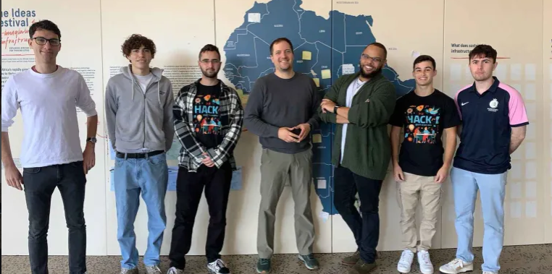
Andrew Mangle
Corey Lee
Dylan Friedman
Gideon Sweijd
Jayden Moore
Nathan Wells
Ryan Schapiro
Interledger

Slide 3


Interledger
Promoting Access to Higher Education:
Reduces socio-economic inequality.
Enhances equity and inclusivity.
Redressing Past Inequalities:
Broadens the economic base.
Improves social mobility.
Breaks the poverty cycle.
Skill Development:
Meets labor market needs, especially in STEM fields. Enhances global competitiveness.

Slide 4

Problem Statement & Hackathon Solutions
Interledger
NSFAS use-case Delayed and Non-Payments
Admin inefficiencies
Tech glitches (NSFAS Platforms are unreliable)
Disrupts academic activities
Financial Stress:
Student uncertainty about fund disbursement
Risk of dropout due to financial strain
Risk of eviction

Slide 5


Additional Challenges Exorbitant Bank Charges: Previous attempts at bank accounts had high fees reverted to students' bank accounts System Inefficiencies: Non-user-friendly online systems, Hinders application process and funding status check Corruption: Mismanagement of funds & Nepotism and bureaucracy
Interledger

Slide 6

Interledger
How will Open Payments solve their problems?
Transparency and Fraud Reduction:
Real-time transaction visibility ensures proper fund usage.
Streamlined and Speed:
Automated processes reduce delays and errors.
Lower Costs:
Decreased transaction fees and administrative overhead.

Slide 7

Keep It Going!
Scalable: Accommodates more students without infrastructure expansion.
Integration: Seamless integration with educational and financial systems.
Convenience and Access: Widened access, mobile/web apps for easier fund management.
Interledger

Slide 8
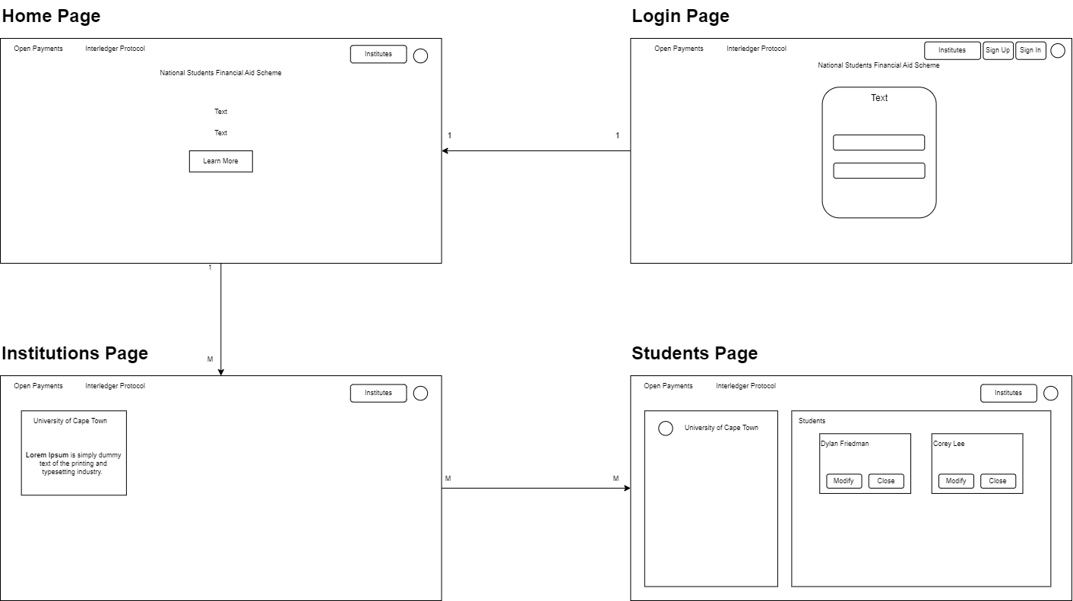
Workflow diagram:

Slide 9
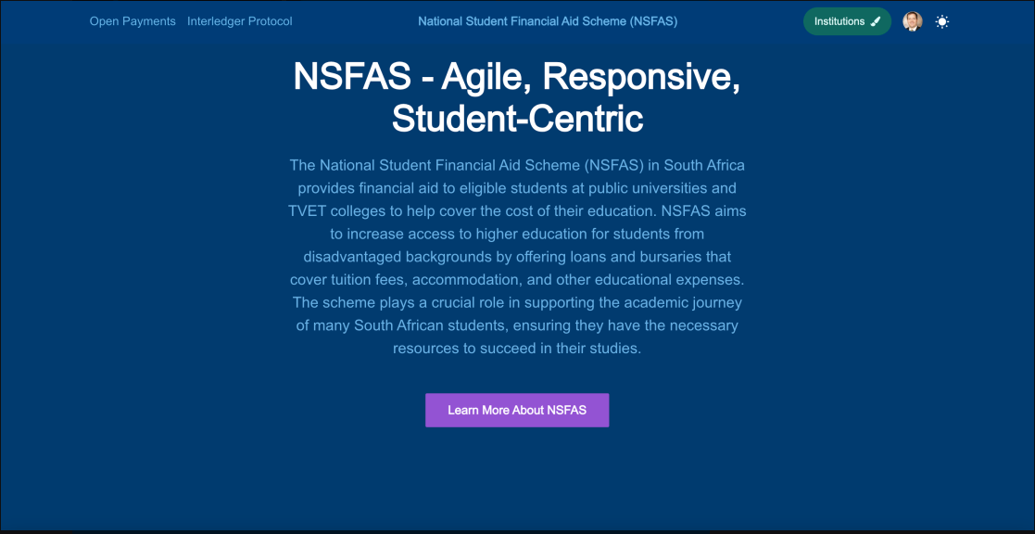
HOME PAGE

Slide 10
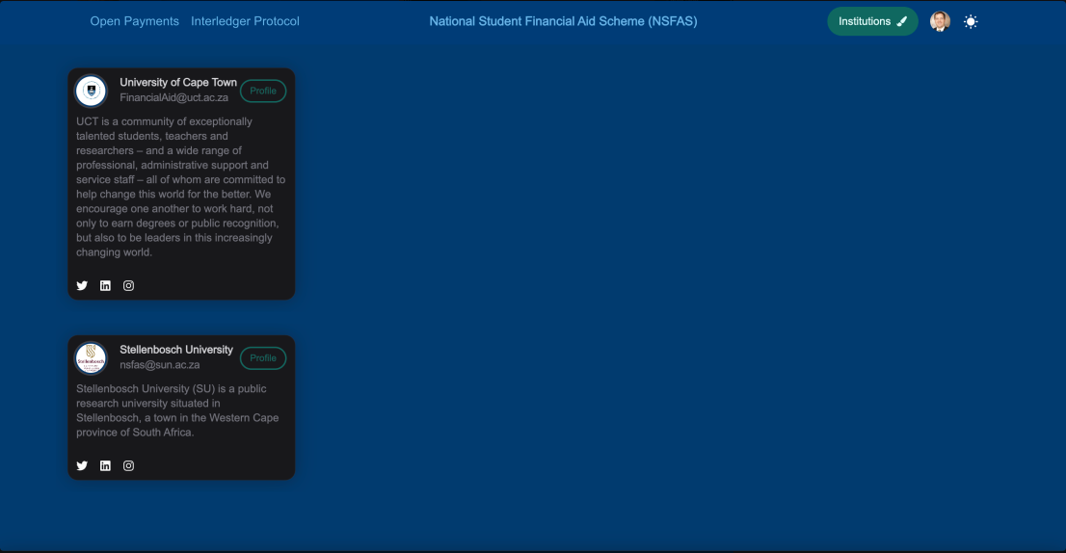
INSTITUTIONS PAGE

Slide 11
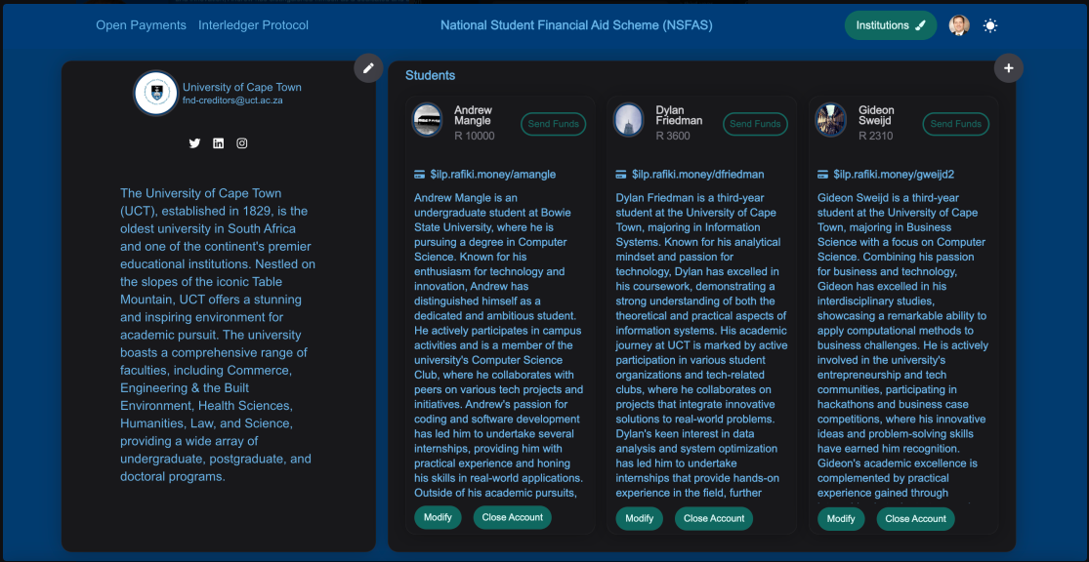
STUDENT PAGE

Slide 12
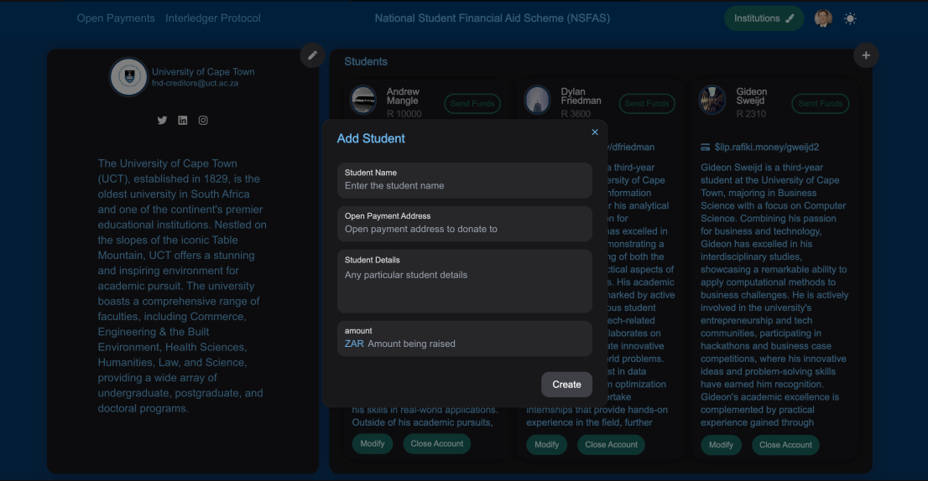
ADD STUDENT PAGE

Slide 13
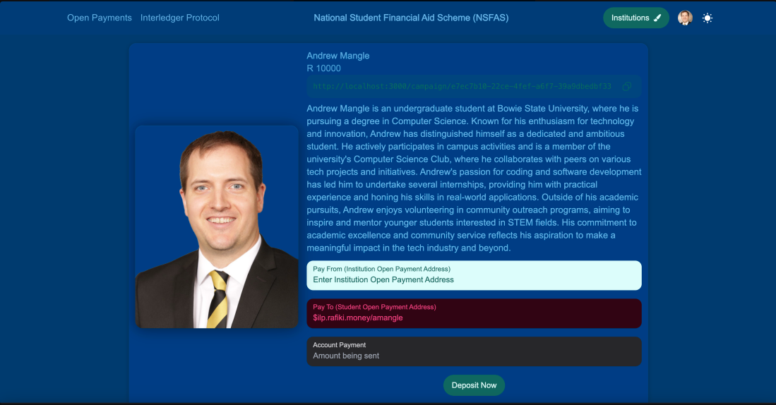
STUDENT INFO

Slide 14
CONCLUSION
Interledger
The web application is designed to securely manage student financial aid by allowing authorized employees to view and manage students' wallet addresses and deposit funds directly.
It streamlines the submission and eligibility process for students applying or reapplying for financial aid, using institution-specific student identification numbers as wallet addresses.
The system supports future enhancements, such as crowdfunding, enabling student representative councils to request and publish wallet addresses for direct donor contributions to students' education and accommodation expenses.
The web application enhances the management of student financial aid by offering a secure platform for authorized employees to handle wallet addresses and deposits, ensuring safe and accurate transactions.
The use of institution-specific student identification numbers streamlines application processes, improving efficiency. Furthermore, the potential for future crowdfunding through wallet addresses paves the way for increased financial support, optimizing current operations and enabling innovative funding solutions for students.

